Slide 1


Transformer Models for Fingerprint Feature Extraction and Matching
EE622: Advanced Biometrics
Week 2 Theory
Summer 2025
Aaron W. Storey
Notes:
Good morning everyone.
Welcome to Week 2 of our advanced biometrics course. Last week, we explored the fundamentals of transformer architectures.
Today, we'll dive deep into how these powerful models can revolutionize fingerprint recognition.
We'll explore the theoretical foundations that make transformers particularly well-suited for capturing both local minutiae details and global ridge patterns - something that has been a longstanding challenge in fingerprint biometrics.

Slide 2
Learning Objectives
Understand fingerprint feature hierarchy
Analyze self-attention for ridge patterns
Compare transformers vs traditional
Hybrid CNN-transformer
Evaluate advantages for edge cases
Notes:
By the end of today's session, you'll understand the theoretical foundations of why transformers are particularly effective for fingerprint analysis.
We'll explore how self-attention mechanisms naturally capture the long-range dependencies in ridge patterns that traditional methods struggle with.
Our terminal learning objective is to explain how transformers solve the global-local representation problem that has challenged fingerprint recognition for decades.

Slide 3
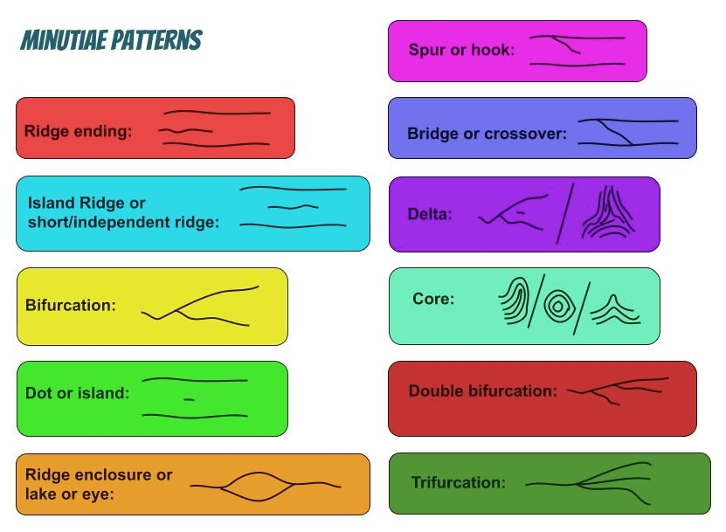
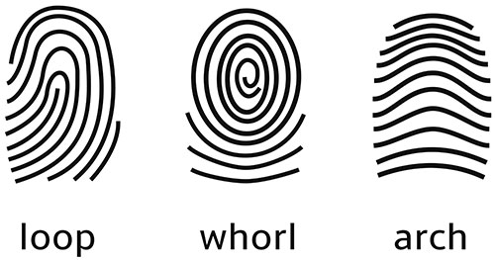
Overview
https://accessdl.state.al.us/AventaCourses/access_courses/forensic_sci_ua_v22/03_unit/03-05/images/ridge_patterns_istock.jpg
https://en.wikipedia.org/wiki/Fingerprint#/media/File:Fingerprints_Minutiae_Patterns_Representation.jpg
https://en.wikipedia.org/wiki/Fingerprint#/media/File:Fingerprints_Minutiae_Patterns_Representation.jpg
Notes:
By the end of today's session, you'll understand the theoretical foundations of why transformers are particularly effective for fingerprint analysis.
We'll explore how self-attention mechanisms naturally capture the long-range dependencies in ridge patterns that traditional methods struggle with.
Our terminal learning objective is to explain how transformers solve the global-local representation problem that has challenged fingerprint recognition for decades.

Slide 4
Overview
https://accessdl.state.al.us/AventaCourses/access_courses/forensic_sci_ua_v22/03_unit/03-05/images/ridge_patterns_istock.jpg
https://en.wikipedia.org/wiki/Fingerprint#/media/File:Fingerprints_Minutiae_Patterns_Representation.jpg
https://en.wikipedia.org/wiki/Fingerprint#/media/File:Fingerprints_Minutiae_Patterns_Representation.jpg
Notes:
By the end of today's session, you'll understand the theoretical foundations of why transformers are particularly effective for fingerprint analysis.
We'll explore how self-attention mechanisms naturally capture the long-range dependencies in ridge patterns that traditional methods struggle with.
Our terminal learning objective is to explain how transformers solve the global-local representation problem that has challenged fingerprint recognition for decades.

Slide 5
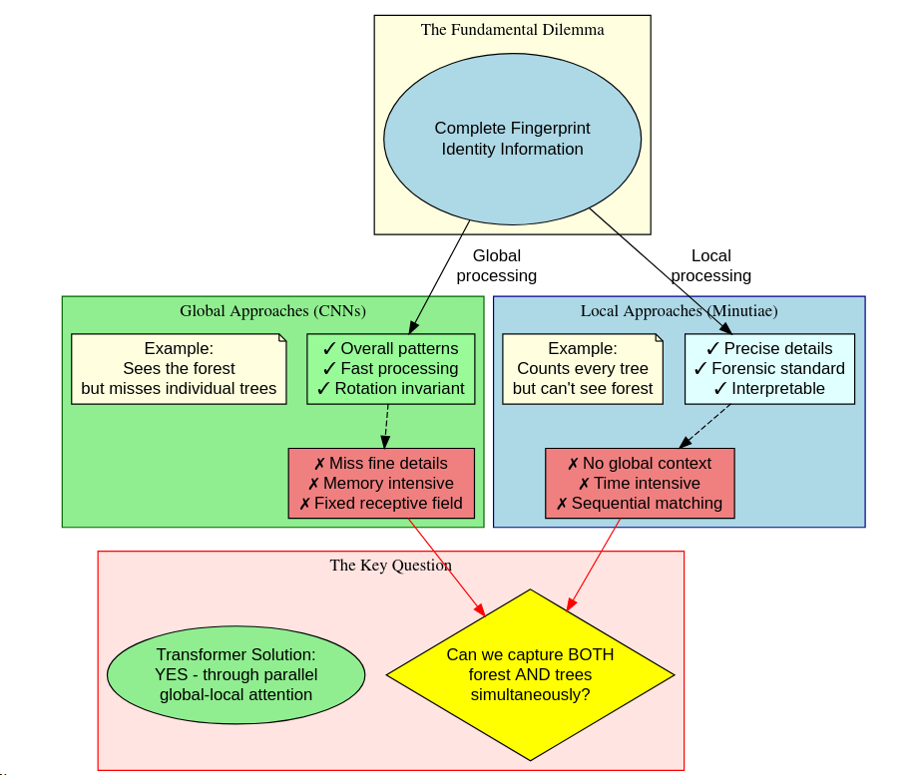
Challenges
Notes:
Fingerprint recognition has faced a fundamental dilemma for decades. Global approaches using CNNs capture overall patterns but often miss critical minutiae details.
Local approaches focus on minutiae but require extensive matching and miss contextual relationships. Traditional CNNs have fixed receptive fields that can't adapt to varying fingerprint sizes or capture long-range ridge dependencies.
The key theoretical question we're addressing today is: can we design a system that simultaneously captures both the forest - the global ridge flow patterns - AND the trees - the individual minutiae points?

Slide 6
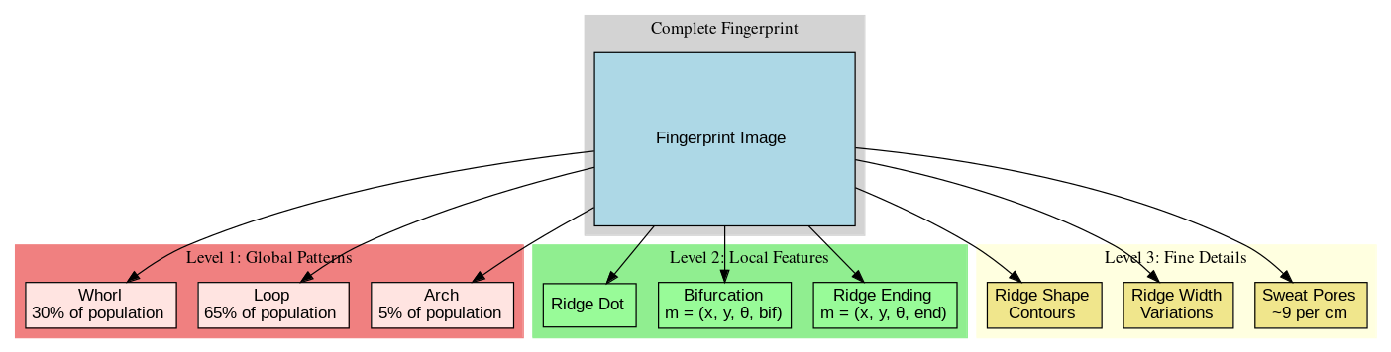
Three-level Hierarchy
Notes:
Let's review the fundamental feature hierarchy from Chapter 4. Fingerprints contain information at three distinct levels.
Level 1 captures global patterns - the overall ridge flow that forms arches, loops, and whorls.
Level 2 focuses on minutiae - specific points where ridges end or bifurcate, mathematically represented by their position, orientation, and type.
Level 3 includes ultra-fine details like pores and ridge width. Traditional systems excel at either Level 1 OR Level 2, but struggle to integrate all three. This is where transformers offer a theoretical advantage.

Slide 7
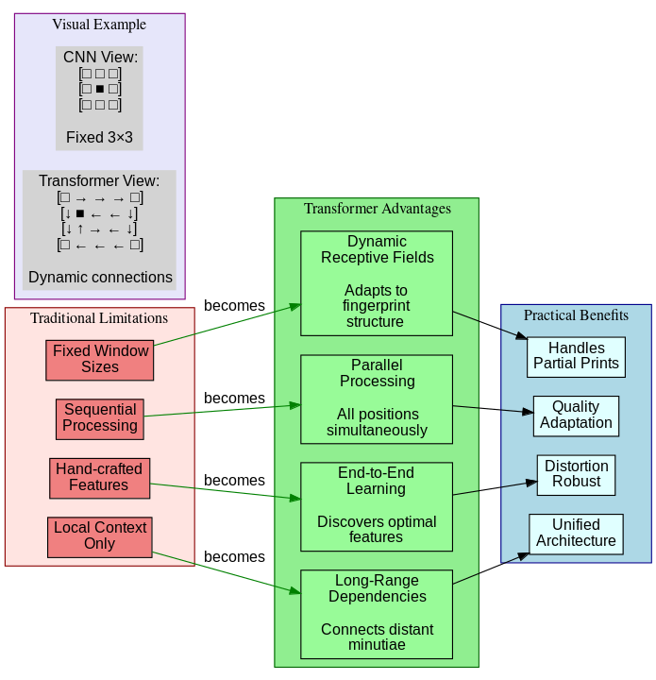
Advantages
Notes:
So why are transformers theoretically superior for fingerprint analysis?
First, their dynamic receptive fields adapt to the fingerprint's structure rather than using fixed windows. The self-attention mechanism naturally captures long-range dependencies - it can connect a minutia at the top of the print with related ridge patterns at the bottom.
Unlike RNNs, transformers process all positions in parallel, eliminating sequential bottlenecks. Most importantly, they learn what features matter through end-to-end training rather than relying on hand-crafted feature extractors.
This flexibility is crucial for handling the natural variability in fingerprints.

Slide 8
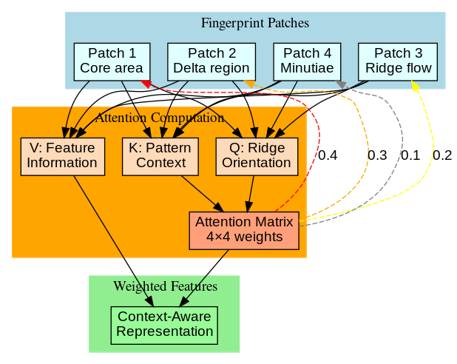
Self Attention Token Structure
Notes:
Let's dive into the mathematics of how self-attention works on fingerprints.
Each fingerprint patch generates three vectors:
Query asks 'what type of ridge pattern am I?',
Key announces 'here's what contextual information I provide', and Value contains the actual features to be aggregated.
The attention formula computes compatibility between queries and keys, creating a weighted combination of values.
In fingerprint terms, a ridge ending (Q) might strongly attend to nearby bifurcations (K) that share similar orientations, helping establish ridge flow continuity.
This mathematical framework naturally captures both local minutiae relationships and global ridge patterns.

Slide 9
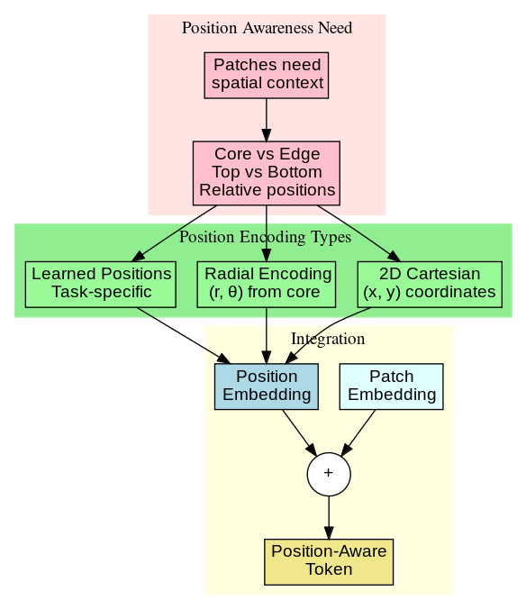
Tokenization
Notes:
Transformers require sequential input, so we must intelligently convert 2D fingerprints into token sequences.
The standard approach uses overlapping patches - typically 32×32 pixels with 50% overlap to maintain ridge continuity across patch boundaries.
Position encoding is crucial: we adapt the standard sinusoidal encoding to 2D, and some approaches use radial encoding centered on singular points like cores and deltas.
A key innovation is quality-aware tokenization - we weight tokens based on local ridge clarity, allowing the model to focus on high-quality regions while gracefully handling noise or damage.

Slide 10
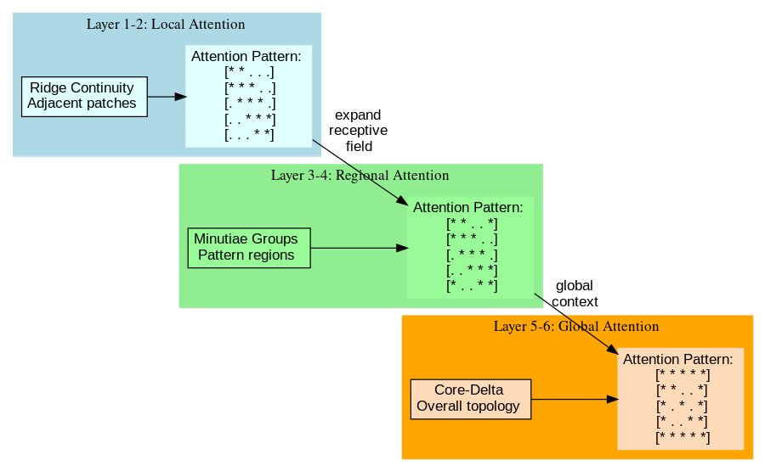
Attention across layers
Notes:
Empirical studies reveal fascinating patterns in how transformers process fingerprints across layers.
Early layers focus on local ridge continuity - attention literally follows ridge paths, even connecting broken segments.
Middle layers begin identifying minutiae relationships, with attention forming constellation patterns between related minutiae.
Deep layers capture global structure, identifying cores, deltas, and overall topology. This hierarchical processing naturally emerges without explicit programming, demonstrating the transformer's ability to discover meaningful fingerprint features through self-supervision.

Slide 11
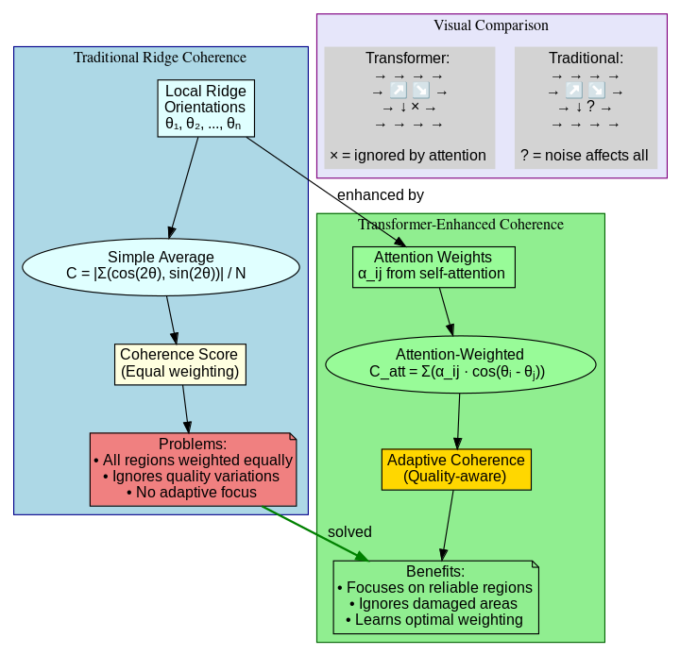
Coherence
Notes:
Let's examine the mathematical relationship between attention and ridge coherence.
Traditional coherence measures average orientation consistency.
The transformer extends this by learning attention weights that emphasize coherent regions.
High attention weights α_ij form between positions with similar orientations, effectively creating an adaptive coherence measure.
This mathematical property explains why transformers excel at maintaining ridge flow continuity even across damaged or noisy regions - they learn to selectively attend to reliable ridge information while ignoring distortions.

Slide 12
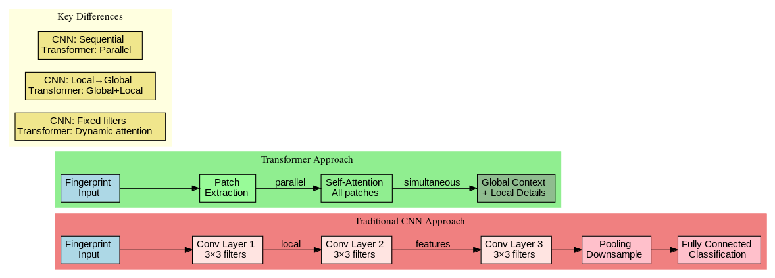
Hybrid CNN-Transformers
Notes:
The hybrid CNN-Transformer architecture represents an elegant theoretical solution.
CNNs excel at local feature detection - they efficiently identify edges, ridges, and basic patterns through convolution.
Their translation equivariance is perfect for low-level fingerprint features. Transformers then process these CNN features, adding global context and long-range dependencies.
This combination leverages CNN's computational efficiency for local processing while utilizing transformers' flexibility for global understanding.
The synergy is powerful: CNNs provide strong local features as tokens, while transformers discover their global relationships.

Slide 13
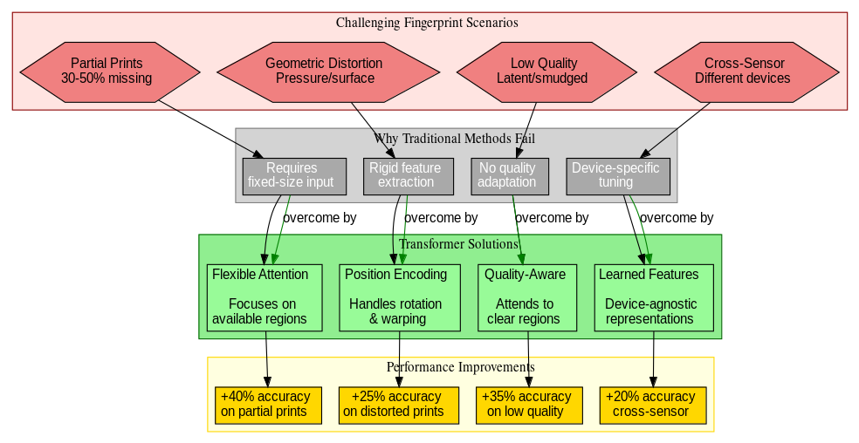
Handling Challenges
Notes:
Transformers offer significant theoretical advantages for challenging scenarios.
For partial prints, the attention mechanism naturally adapts to whatever regions are available - there's no requirement for complete, centered fingerprints like traditional matchers.
Geometric distortions from pressure or surface curvature are handled through flexible position encoding and rotation-agnostic attention patterns.
For low-quality or latent prints, the model learns to selectively attend to clear regions while using global context to infer missing information.
This adaptability stems from the transformer's fundamental design - it makes no rigid assumptions about input structure.

Slide 14
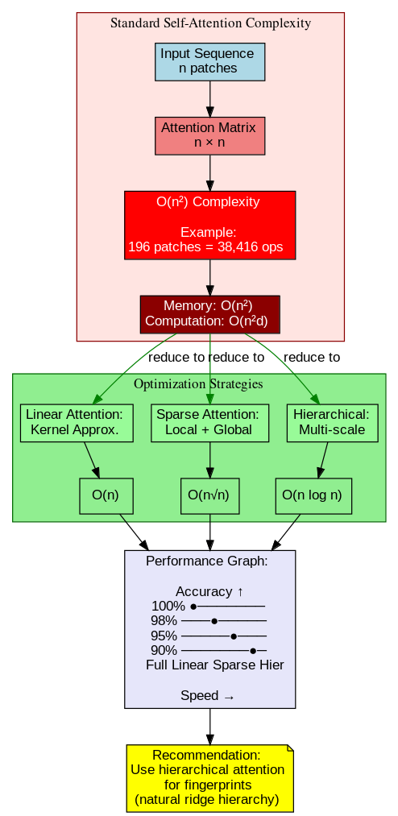
Complexity Analysis
Notes:
While transformers offer powerful capabilities, we must consider computational complexity.
Standard self-attention is O(n²) where n is the number of patches - this becomes significant for high-resolution fingerprints.
However, fingerprint structure allows optimizations: we can use linear attention approximations or sparse patterns that follow ridge structures.
Some architectures combine local attention windows for minutiae with global attention for overall structure. T
The key insight is that not every patch needs to attend to every other patch - ridge patterns have natural locality we can exploit while maintaining global awareness.

Slide 15
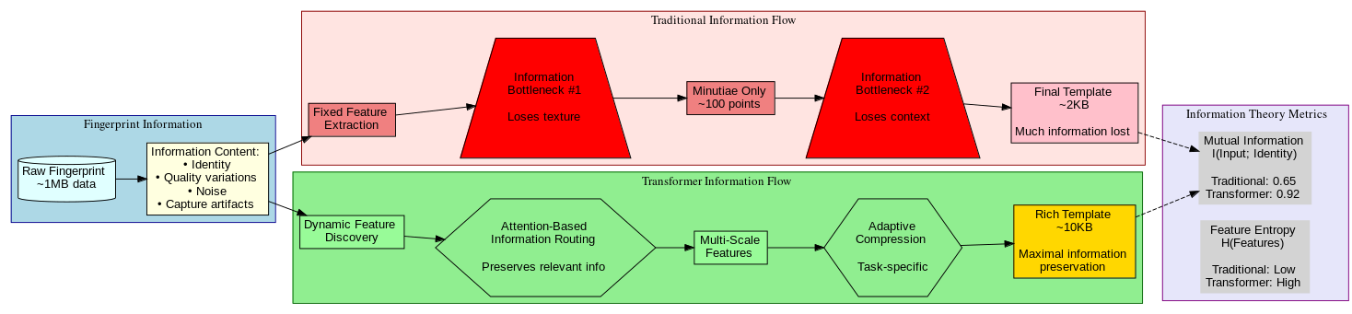
Information Theory Perspective
Notes:
From an information theory perspective, transformers maximize mutual information between input and identity.
Traditional methods create information bottlenecks through fixed feature extraction - valuable discriminative information is lost early in the pipeline.
Transformers dynamically route information through attention, preserving more discriminative details.
The end-to-end learning discovers which feature combinations are most informative for identity verification.
This theoretical advantage translates to practical improvements, especially for difficult matches where every bit of information matters.

Slide 16
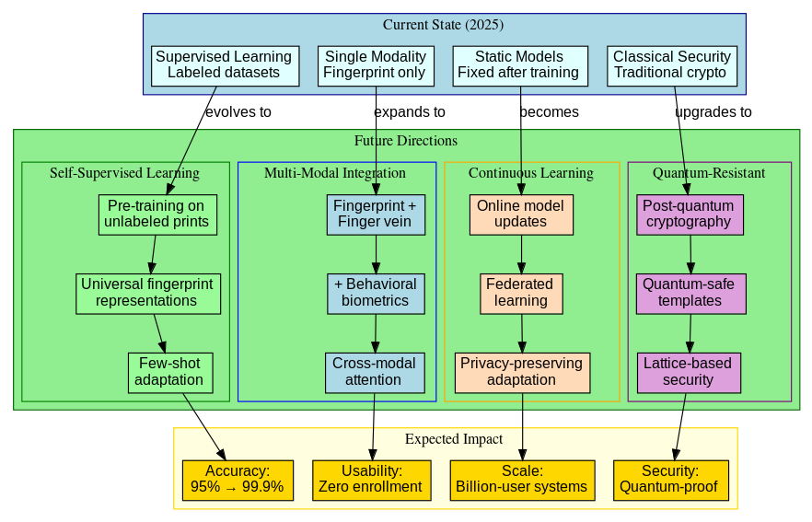
Theoretical Directions
Notes:
From an information theory perspective, transformers maximize mutual information between input and identity.
Traditional methods create information bottlenecks through fixed feature extraction - valuable discriminative information is lost early in the pipeline.
Transformers dynamically route information through attention, preserving more discriminative details.
The end-to-end learning discovers which feature combinations are most informative for identity verification.
This theoretical advantage translates to practical improvements, especially for difficult matches where every bit of information matters.

Slide 17
Summary
Transformers solve the global-local dilemma through adaptive attention
Self-attention naturally captures ridge relationships and minutiae constellations
Hybrid architectures combine CNN efficiency with transformer flexibility
Superior handling of partial prints and distortions
Information-theoretic advantages through dynamic feature routing
Notes:
Let's summarize the key theoretical insights.
Transformers elegantly solve fingerprint recognition's fundamental dilemma by simultaneously capturing local minutiae and global patterns through adaptive attention.
The self-attention mechanism naturally models ridge relationships without explicit programming.
Hybrid CNN-transformer architectures achieve both computational efficiency and representational power.
Most importantly, transformers don't just incrementally improve existing methods - they fundamentally change how we model fingerprint identity, moving from rigid feature extraction to dynamic, context-aware processing.
Next week, we'll dive deeper into specialized attention mechanisms for minutiae detection. Thank you for your attention - I'm happy to take questions about the theoretical foundations we've covered today.

